Slide 1
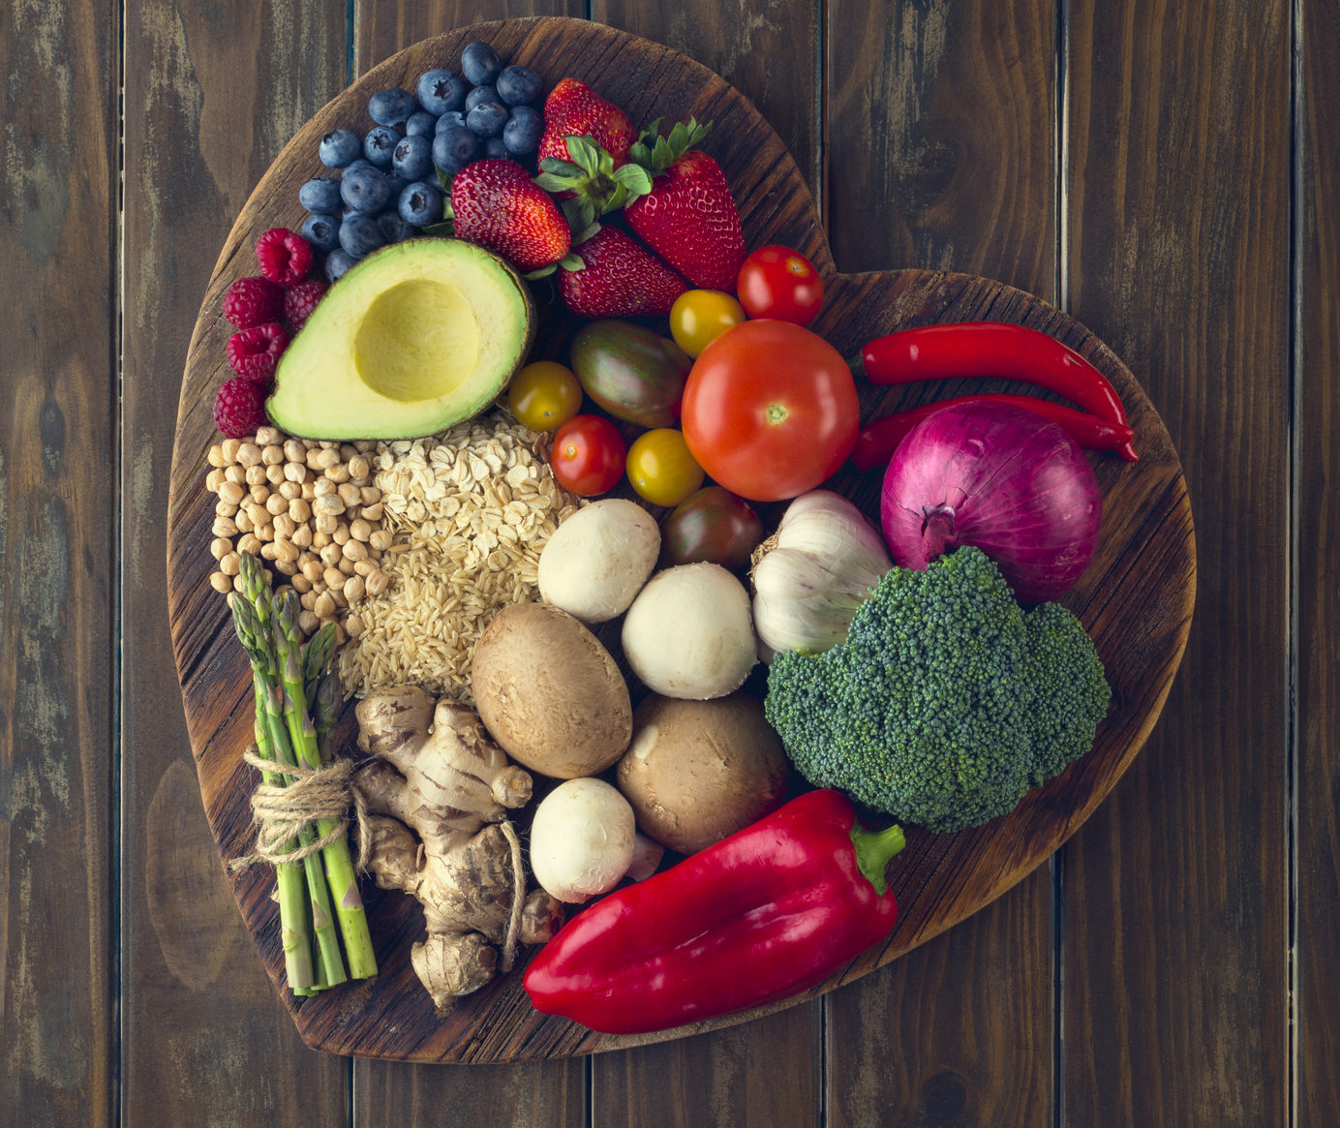
PROMOTING HEALTHY EATING
&
BALANCED DIET

Slide 2
Agenda:
Team Members
Improvements from professor feedback
Project description
Problem statement
Minimal Viable Product (MVP)
Technologies
Architecture diagram
Sprint2 Recap
Product backlog
Sprint backlog
Metrics
Retrospective​
Sprint4
Project Demo
Live application demo
Git-hub link
Live Application Demo

Slide 3
Meet the team

Slide 4
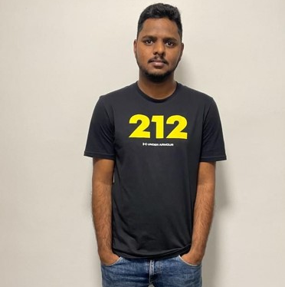
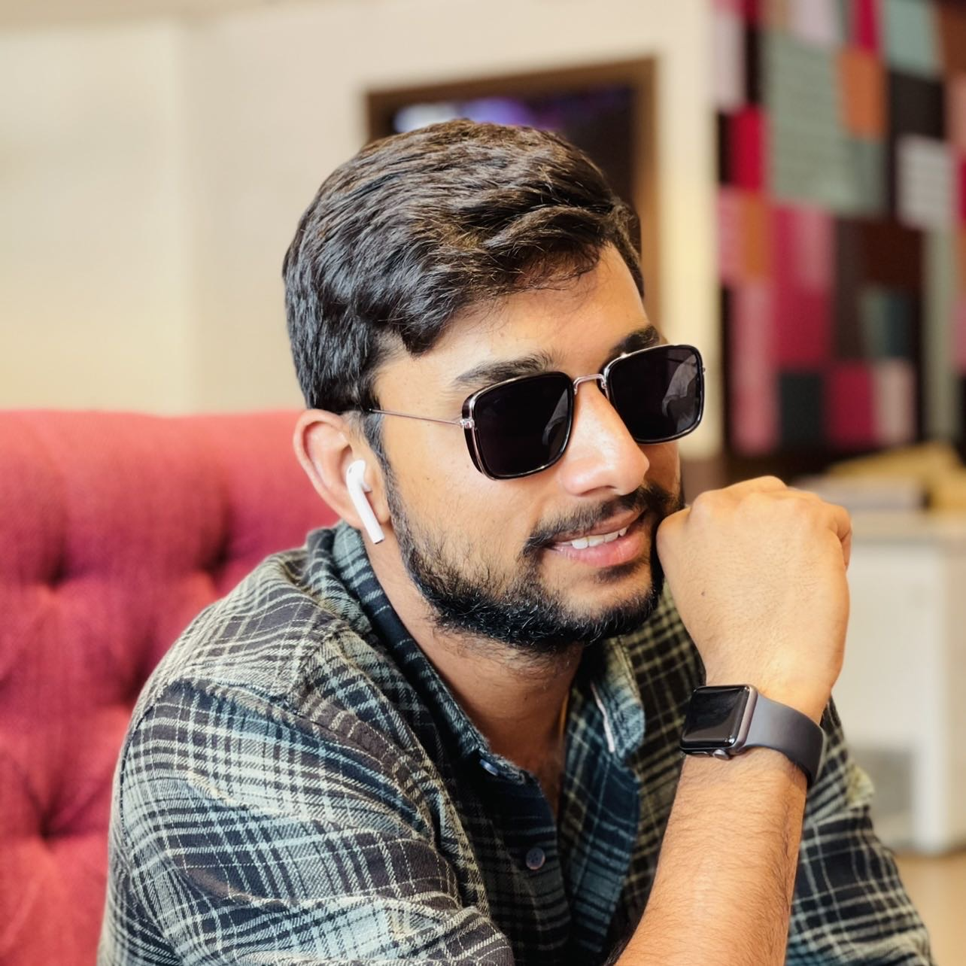
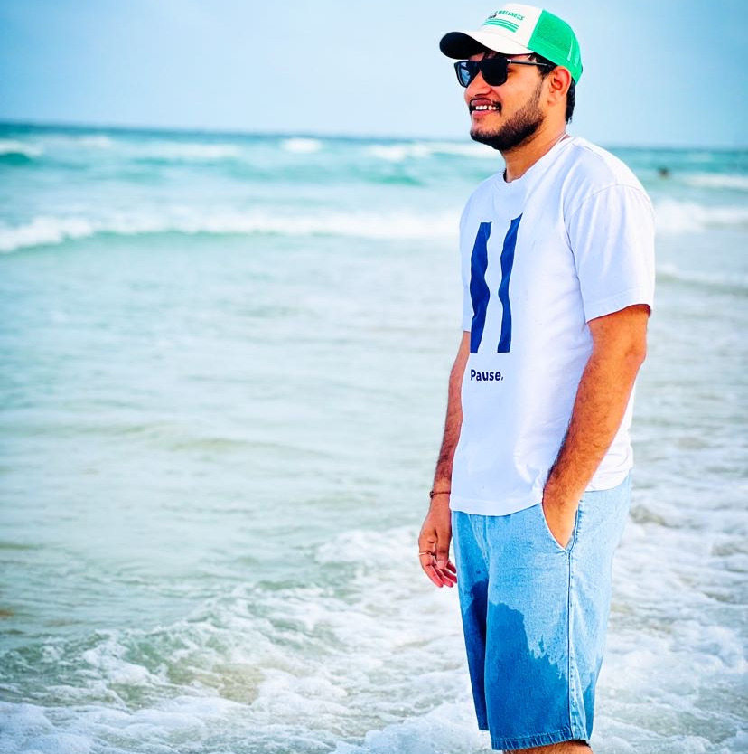
SATHWIK MUDENTI
VARUN REDDY DUGGIMPIDI
NARESH BABU CHINTA
BACKEND DEVELOPER
BACKEND DEVELOPER 2
QA/TESTER

Slide 5
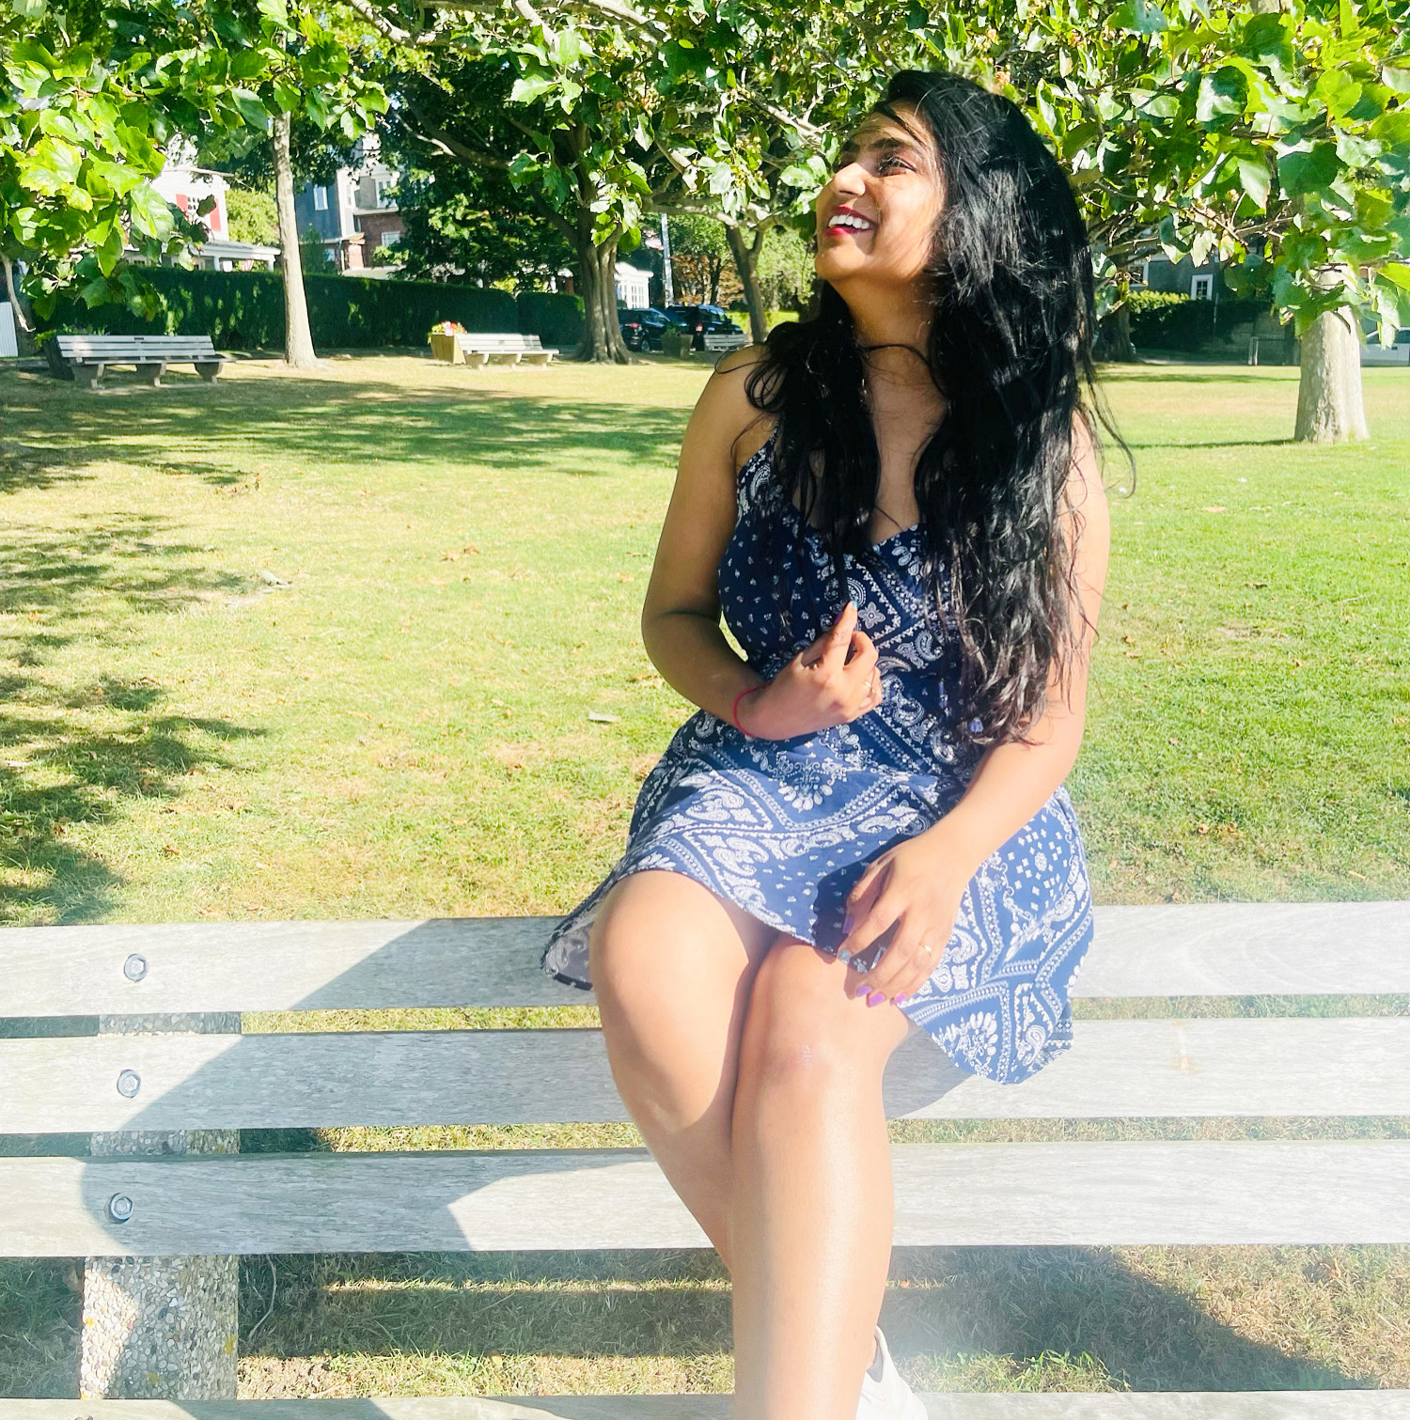
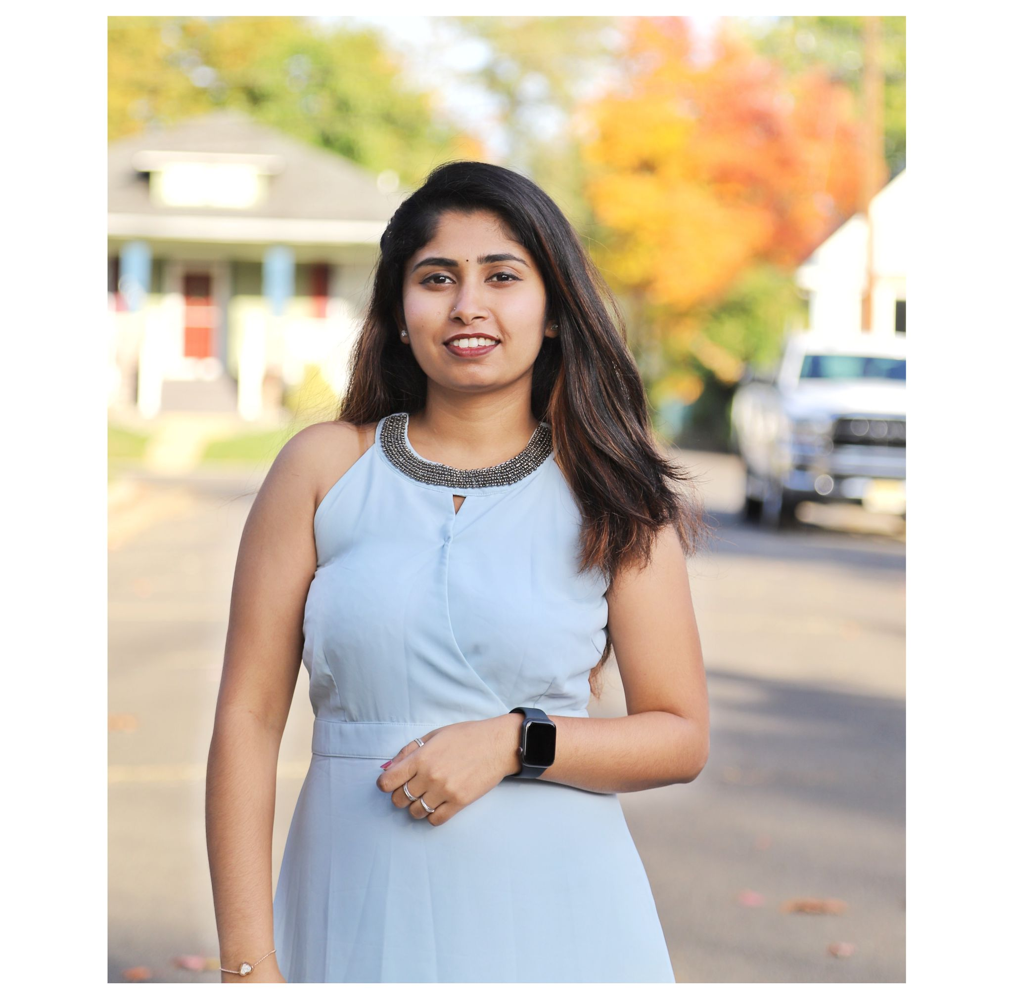
Dharini Maanasa
BRUNDA REDDY
FRONTEND DEVELOPER
DBA

Slide 6
TEAM
AGREEMENT

Slide 7
We makes sure team has clear objectives of the project.
Make a list of all the tasks that need to be completed.
Being engaged and stay committed to submit deliverables on time.
Encouraging each other to complete the tasks given.
Understanding what is expected and what needs to be delivered.
Making sure every teammate providing the equal amount of contribution.
Providing the feedback within the team to perform better.

Slide 8
PROBLEM STATEMENT

Slide 9
PROBLEM STATEMENT:
People like to taste different cuisine and choose the most appealing food. They often are concerned about diet restrictions such as gluten-free, vegan, ketosis, peanut-allergy, and calorie count.
We would like to provide an easy solution to making health and good foods that fit your daily calorie consumption limit.

Slide 10
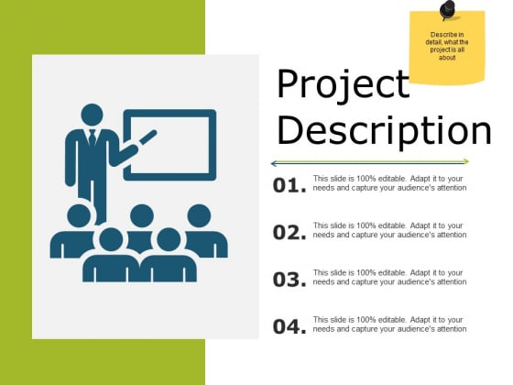
PROJECT
DESCRIPTION

Slide 11
The project focuses on four major problem statements:
Food Classification.
Recipe Generation.
Balanced Diet.
Calorie Estimation.
From the image of food captured, we determine the classification of food (such as donut, samosa, biriyani), identify the calorie count and describe the cooking procedure of the food. With this information, an informed decision can be made on making the item or not.

Slide 12
Food Classification:
Food classification is a challenging problem due to the large number of food categories, high visual similarity between different food categories.
It’s multi-class classification problem to predict the 251 fine-grained food-categories.

Slide 13
Recipe Generation:
Recipe Generation problem is resolved by three major sub-networks.
Food understanding (Extracting ingredients)
Multi-label classification (Detecting the food title)
Conditional text generation (NLP)(Preparing recipe)
The pipeline extracts the image representation with resnet-50 encoder and obtain the ingredients. Recipes are generated with identified ingredients into human readable format.

Slide 14
Balanced Diet:
A balanced diet is one that contains all the essential elements that the human body needs.
Carbohydrates, lipids, vitamins, minerals, proteins, fiber and water are all essential components in a well-balanced diet.
A nutritious, well-balanced diet lowers the risk of disease and enhances general health.

Slide 15
Calorie Estimation:
From the ingredients generated from Recipe module, we have computed the Calorie for the dish.
Each recipe provided us the nutritional value for every 100 grams.
Fat/ Saturation - Every gram of fat has 37 kilojoules.
Protein - Every gram of protein has 17 kilojoules.
Sodium - Every gram of sodium has 8 kilojoules.
Sugar - Every gram of sugar has 17 kilojoules.
Every kilojoule has 0.239006 calories.
Using this data we used the following formula to estimate calories.
0.24((fat * 37) + (protein*17) + (sodium *8) + (sugar * 17)) = total calories.

Slide 16
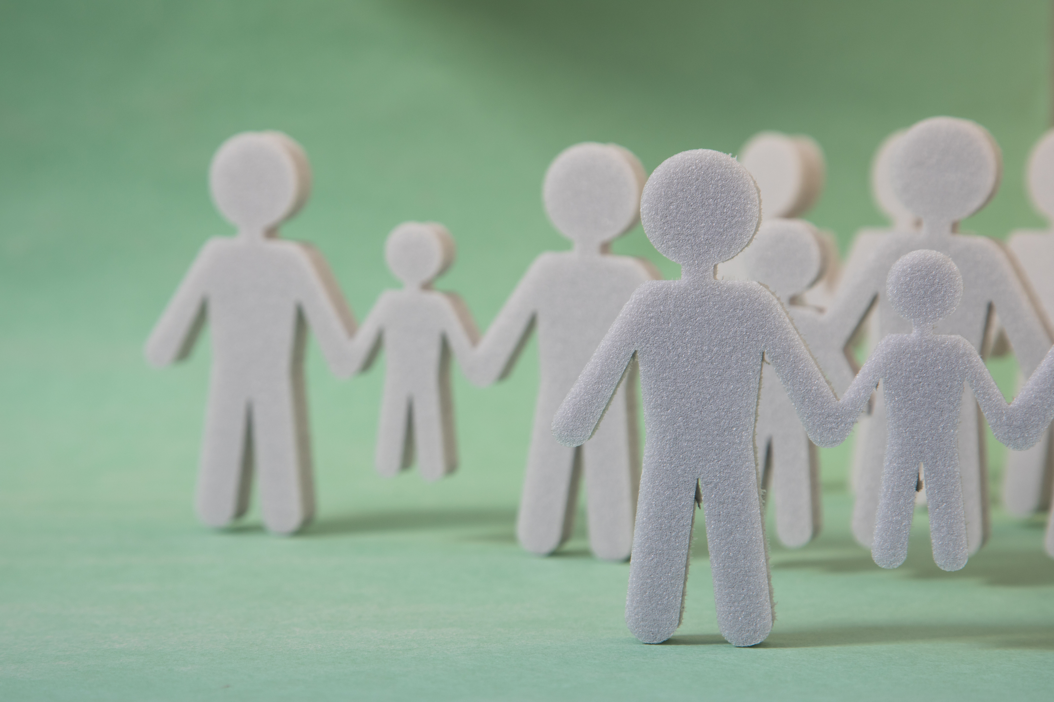
PERSONAS

Slide 17
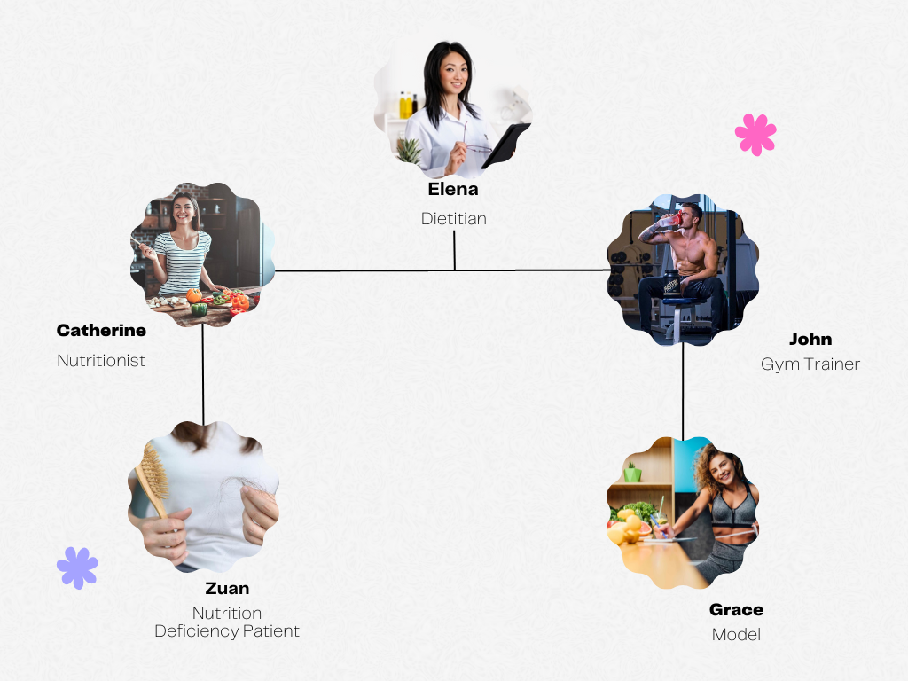

Slide 18

Elena
Dietitian
Elena is an expert Dietitian.
She is 33 years old beautiful dietitian.
She is a qualified health professional who helps patients with nutrient deficiency.
She is registered with the Commission of Dietetics Registration (CDR)
She has a license to practice as diet and nutritional consultant.

Slide 19

catherine
nutritionist
She is a certified Nutritionist .
She works with healthy people to promote healthy eating habits.
She helps in creating awareness to prevent diseases related to nutrient deficiencies.
She uses an online health assessments to curate a daily supplement routine tailored needs.
Catherine is smart enough to understand the people's health condition and helps to get medications, supplements to them.

Slide 20
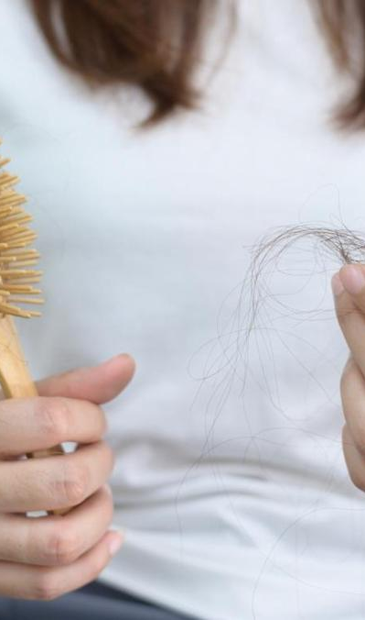
Zuan
Nutrition deficiency patient
Zuan is 24 years old who is suffering from Nutrition Deficiency
She has signs of B12 and suffering from dry skin, severe hair fall and brittle nails.
She need awareness about a good diet and healthy food habits.
She needs treatments including supplementation, change in diet, lifestyle and eating disorders.

Slide 21
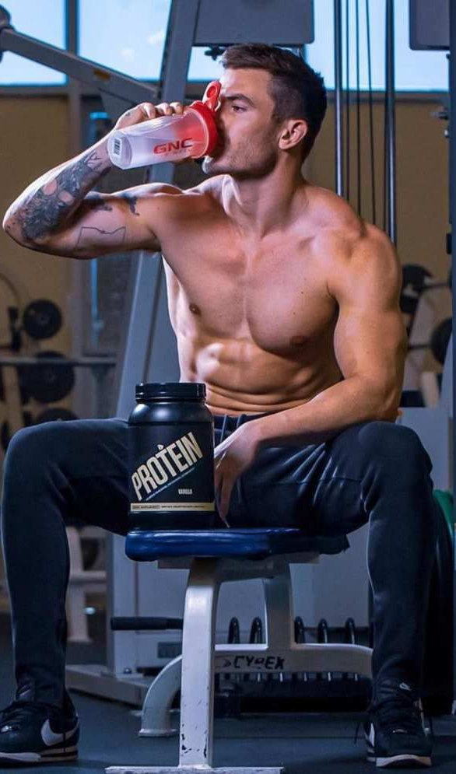
john
Gym trainer
John is a successful personal trainer in one of the best gyms.
He have a good knowledge about what his clients eat is as important as their training regimen.
He helps his client to reach their individual goals.
John knows having the right mix of calories and macros from whole foods is most important.
He make an individual diet plan for his clients.

Slide 22
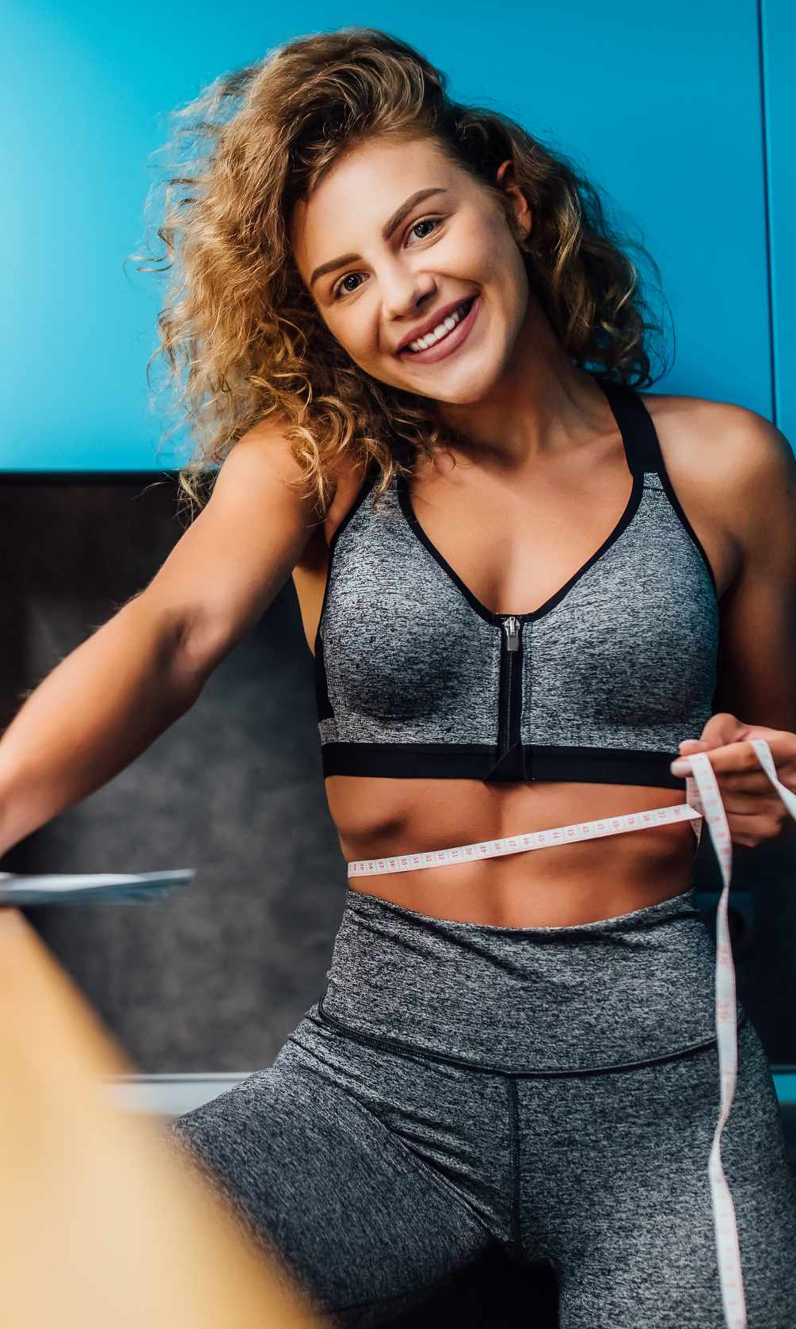
grace
MODEL
Grace is 22 year - young and an upcoming model.
Grace loves to be active and physically fit.
She is very much concerned about the food she eats.
She spends 2 hours a day in gym.
She follows a proper diet provided by her trainer.

Slide 23
MINIMAL VIABLE PRODUCT

Slide 24
We would Like to Implement following features as a part of our MVP
User registration
Login
Home Page
Display all the features on the home screen of the Application
Implement a particular feature called Maintenance Calorie Calculator using API

Slide 25





TECHNOLOGIES

Slide 26




TECHNOLOGIES

Slide 27
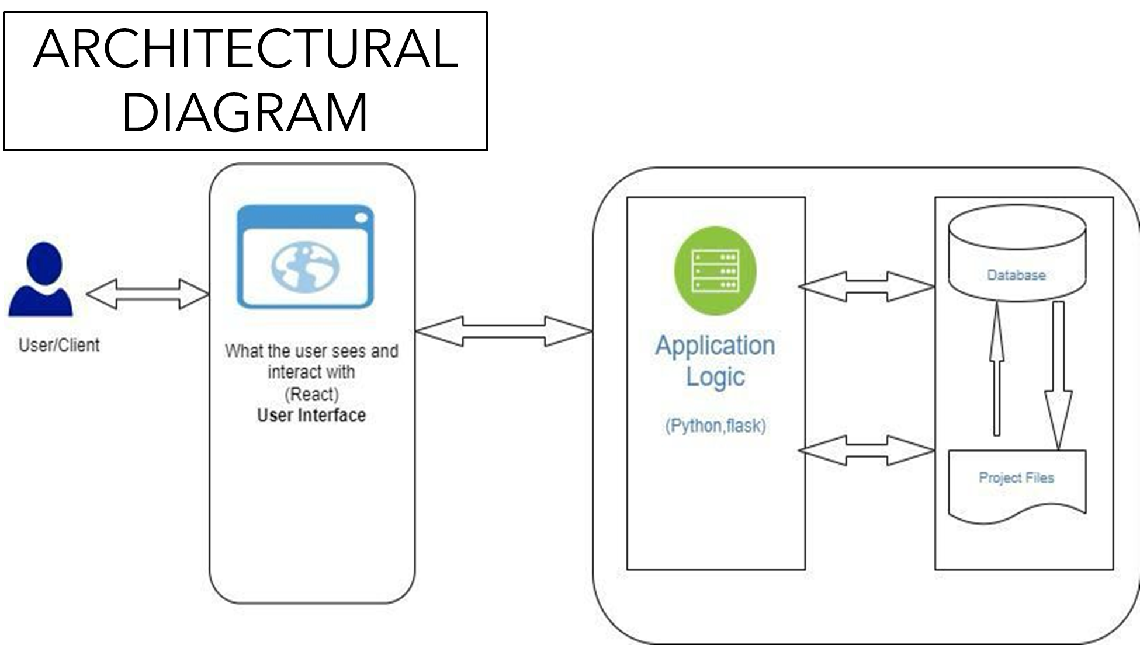

Slide 28
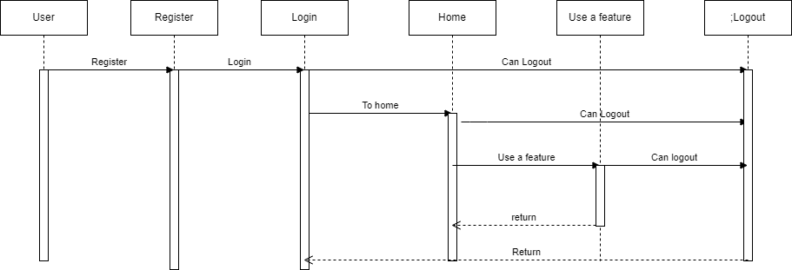
SEQUENTIAL ARCHITECTURAL DIAGRAM

Slide 29
SPRINT 2 RECAP
We need to complete the MVP.
Need to create a Login Page.
Improvements made from professor’s feedback.
Product Backlog.
Stories that are planned for sprint.

Slide 30
SPRINT 3
Work on the Draft Paper.
Created a Sign/Login Page.
Work on more user stories.
Created a new Architectural Diagram
Design Backend and Work on Database.

Slide 31
PRODUCT BACKLOG

Slide 32
PRODUCT BACKLOG
^SAT-1 AS a new user I want to register using email and create password
^SAT-2 As a new User if I enter wrong Invalid email I want to get an alert
^SAT-3 As a new User I want to
^SAT-11 As a User I want to get informed when I enter invalid password so that I can enter correct one.
^SAT-9 User can recover his password in case if he forgot his password
^SAT-10 User can choose a security questions to retrieve his account information
^SAT-4 As User I want to enter his information like age,height,weight,activity status so that I can get recommendations based on my Inputs
^SAT-5 As a User I want to navigate to all the services listed in the application so that I become familiar with the application

Slide 33
SPRINT BACKLOG
&
USER STORIES

Slide 34
User Stories for the Sprint
Id | Test Cases | User Stories
SAT-1 | As a new user​ I want to register using email​ So that I can login to the application | scenario when user wants to register​ Given he registers​ Then his information gets stored​ And he can login using email and password
SAT-11 | As a new user​ I want to login to the application, but I enter wrong credentials​ So that I get alerted using a popup message that my credentials are invalid | Scenario when user wants to login​ Given he enters wrong credentials ​ Then he gets notified by an alert to enter valid credentials.​ And the system asks him to enter right information
SAT-06 | As a new user ​ I want to navigate using a search on the web page​ So that I can navigate quickly | Scenario when user wants to navigate quickly​ Given he uses search-bar on top of the application​ Then he can navigate quickly using search-bar

Slide 35
TEST CASES

Slide 36
Test case for sign-up
Test Id | Test Unit | Test Description | Test data | Expected output | Test result
SAT-1 | Register | User registers with email and password | Email:test1@gmail.com Password:Test1@123 | User Successfully registered | Pass
SAT-1 | Register | User registers with email and password | Email:test1@gmail.com Password:Test1@123 | User already exist with same username | Pass
SAT-3 | Register | User registers with email and password | Email: test Password:Test@123 | Email Invalid | Pass
SAT-1 | Register | User registers with email and password | Email:Test2@gmail.com Password:test12 | Password should contain minimum of 8 characters | Pass
SAT-1 | Register | User registers with email and password | Email:test2@gmail.com Password:test1234 | Password should contain lower and uppercase letters and special character | Pass
SAT-2 | Login | User Logins with email and password | Email:test1@gmail.com Password:test1@123 | User Logged in successfully | Pass
SAT-2 | Login | User logins with email and password | Email:test2@gmail.com Password:test1@123 | Invalid email | Pass
SAT-2 | Login | User logins with email and password | Email:test1@gmail.com Password : test2@123 | Invalid password | Pass
SAT-5 | Home | User navigates through the catalogue of features |  |  | Pass
SAT-5 | Home | User clicks on service catalogue and finds about features |  | User finds about what these features are capable of | Pass

Slide 37
STORIES COMPLETED

Slide 38
Id | User story | Acceptance Criteria
SAT-1 | As a new user​ I want to register using email​ So that I can login to the application | scenario when user wants to register​ Given he registers​ Then his information gets stored​ And he can login using email and password
SAT-11 | As a new user​ I want to login to the application, but I enter wrong credentials​ So that I get alerted using a popup message that my credentials are invalid | Scenario when user wants to login​ Given he enters wrong credentials ​ Then he gets notified by an alert to enter valid credentials.​ And the system asks him to enter right information
SAT-06 | As a new user ​ I want to navigate using a search on the web page​ So that I can navigate quickly | Scenario when user wants to navigate quickly​ Given he uses search-bar on top of the application​ Then he can navigate quickly using search-bar

Slide 39
STORIES NOT COMPLETED

Slide 40
Id | Acceptance criteria | Summary
SAT-4 | As a new user I want to enter inputs like age, height ,weight ,activity so that I get recommendations based on my information | Scenario when user wants to give inputs Given he gives inputs and press submit Then his information gets stored And The system displays his information
SAT-5 | As a new user I want to navigate to all the services in the application So that I get familiar with all the services of the application | Scenario when user wants to navigate Given he wants to get familiar with all the services in the application Then user can get to know all the services in the application
SAT-9 | As a user I want to reset my password if I forgot one So that I can login again | Scenario when user forgets his password Given he changes his password Then the system stores his new password And he can login with his new password
SAT-8 | As a new user I want to edit my personal information So that I get recommendations based on changed information | SCenario when user want to edit his information Given the customer navigates to information. Then he changes his information. And he submits the information.

Slide 41
METRICS

Slide 42
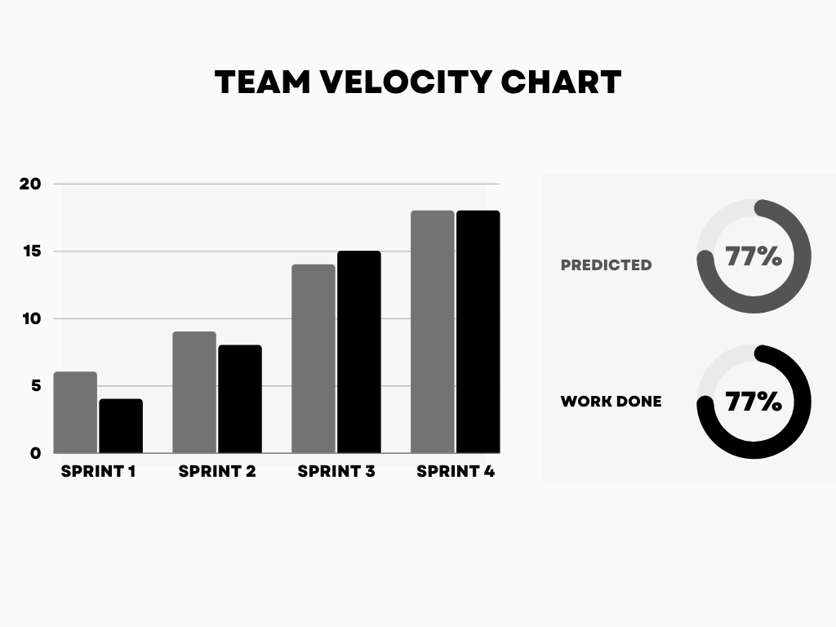

Slide 43
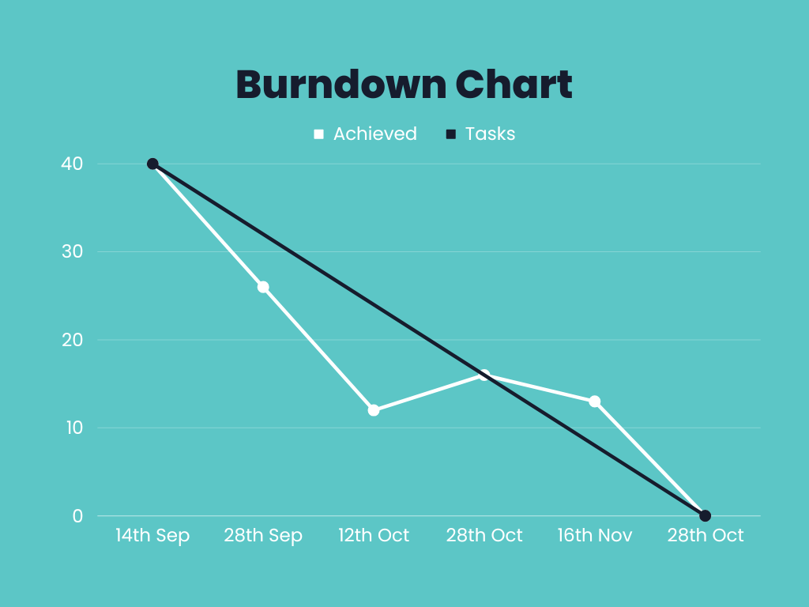

Slide 44

RETROSPECTIVE

Slide 45
What went well?
Meetings went according to the scheduled manner and the team members complemented each other well.
We tried to finish the deliverable on time
We worked on MongoDb

Slide 46
What didn’t go well?
Took more time to work on sign-up and login page
Team needs to be more focused about deadlines and submissions.
Team is still unaware of

Slide 47
Next steps?
Each members need to take initaiative and work on the deliverable .
Research on deep learning algorithms and learn how to do Integration.

Slide 48
SPRINT - 5

Slide 49
Stories Planned for Sprint 4
ID | Product Backlog
SAT-4 | As a new user I want to enter my inputs like age,height,weight,activity so that I can get recommendations based on my information
SAT-5 | As a new User I want to navigate to all the services in the application so that I can get familiar with the services of the application
SAT-9 | As a new user I want to click on the services so that I get to know what is the service capable of .
SAT-8 | As a new user I want to edit my personal Information so that I can get recommendations based on my Information

Slide 50
APPLICATION SCREENSHOTS

Slide 51
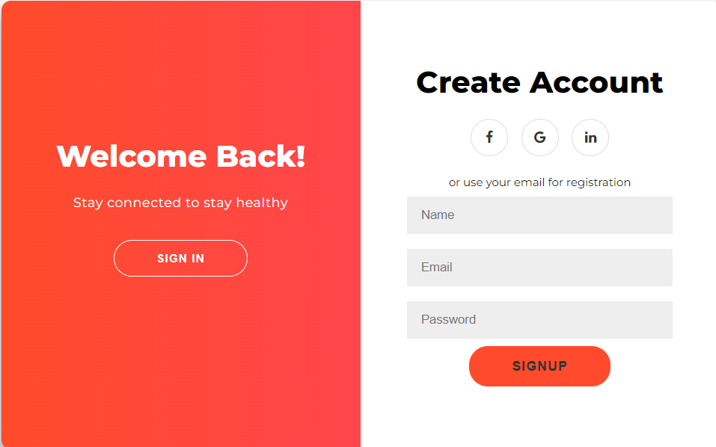

Slide 52
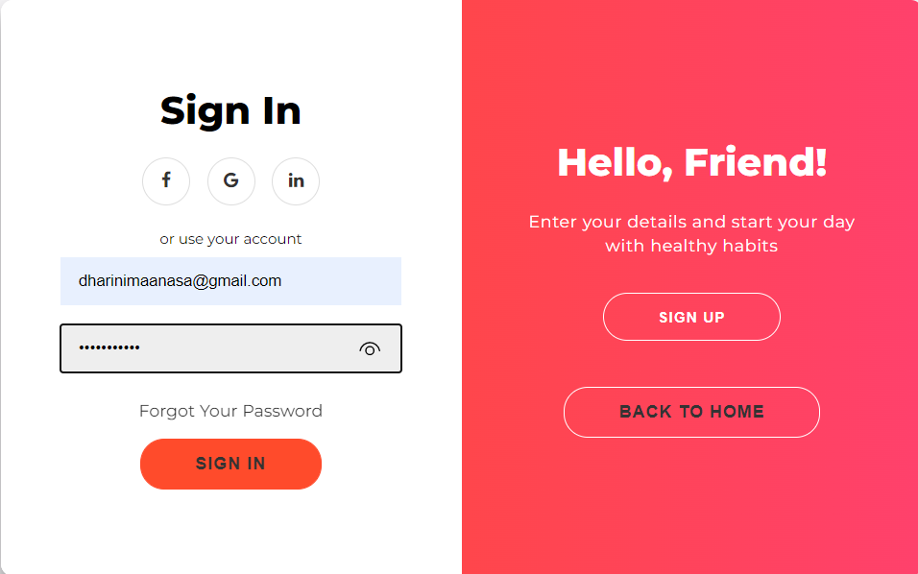

Slide 53
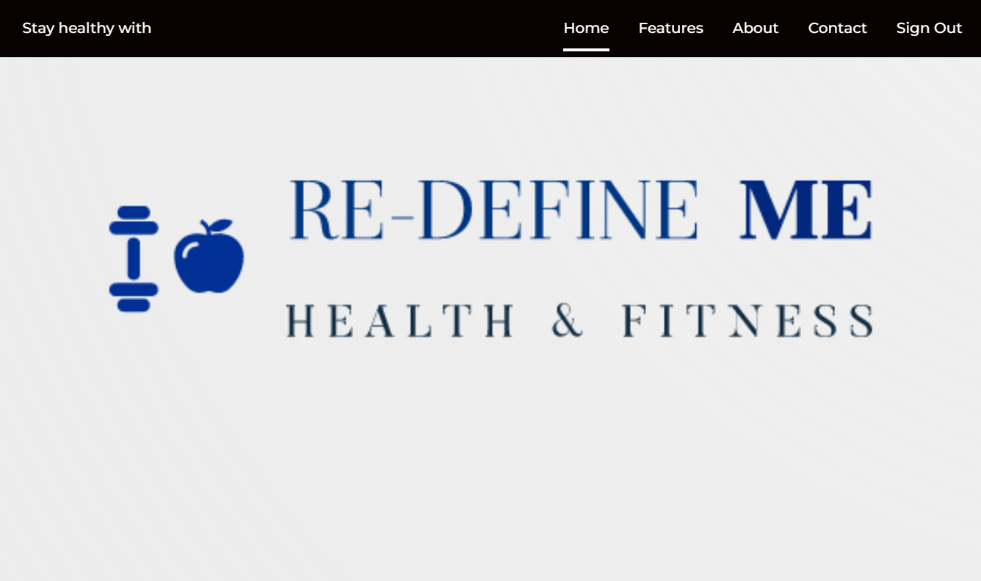

Slide 54
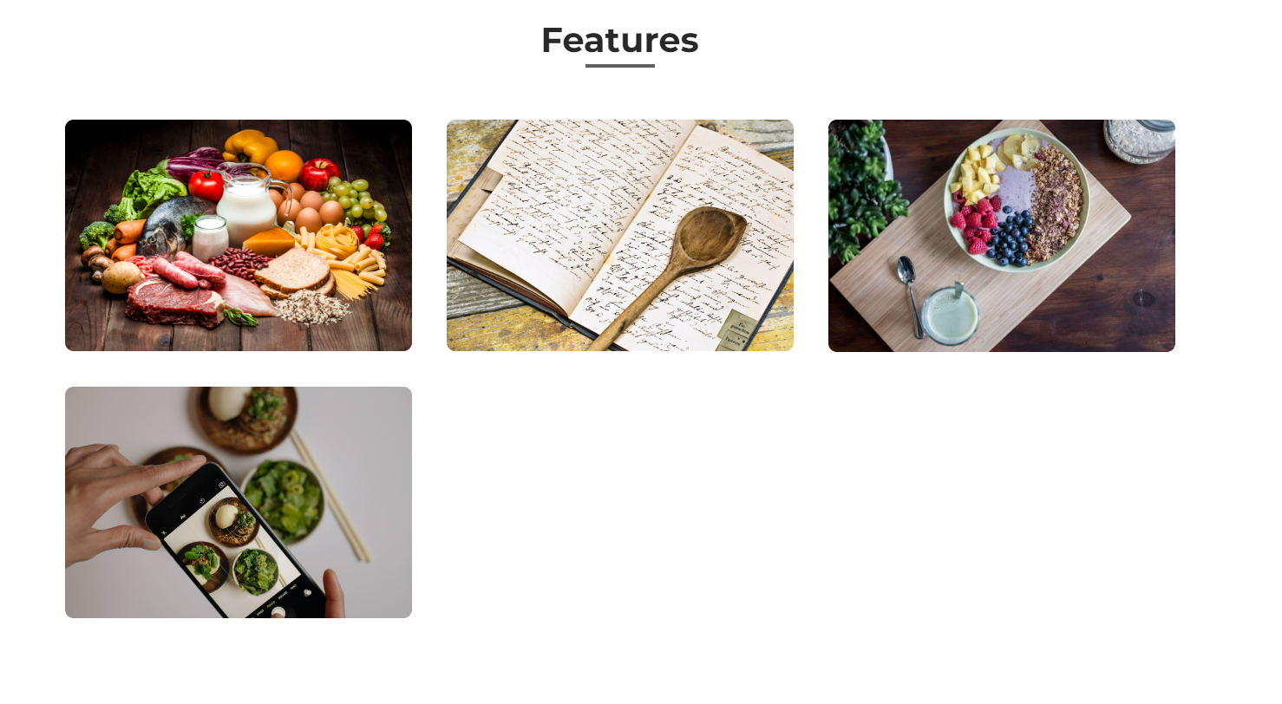

Slide 55

Git-hub Link
https://github.com/DhariniMansi/CS691.wiki.git

Slide 56
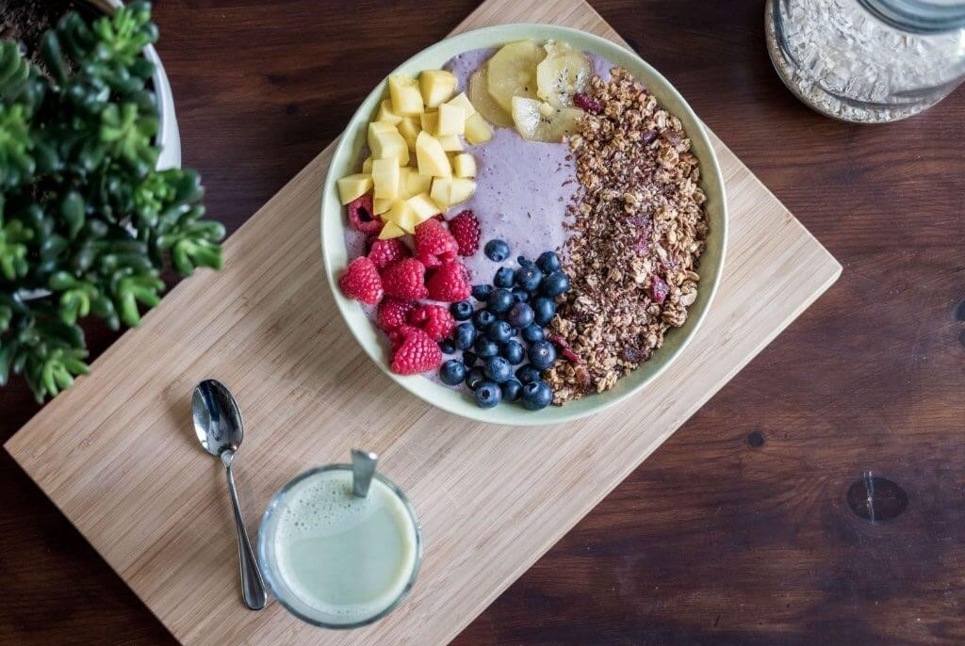
Happy eating
THANK YOU

